Slide 1
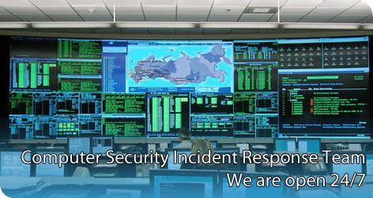
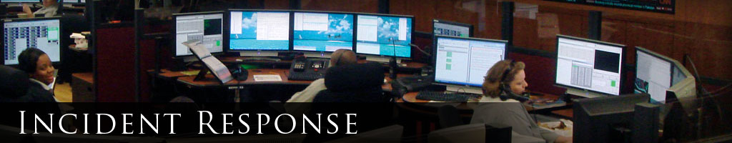
CIS 5930/4930
Offensive Security
Spring 2013

Slide 2
What is an Incident?
Refers to a security breach or attack
DoS
Data leaks
Confidential
PII
IP
Secret
Sabotage
data corruption
Malware

Slide 3
What is Incident Response?
Is an organized approach to addressing and remediating the aftermath of a security breach / attack.
The Goal(s):
To limit the damage of the incident
To limit the recovery time
To limit the costs incurred by the incident
Common Challenges:
Budgets, resources, limited personnel
Bureaucracy, Share/Stakeholders

Slide 4
Incident Responder Roles
The following roles must be part of an effective IR team:
Incident Coordinator
Keep track of everything, address expectations, understands bureaucracy, understands laws/regs
Incident Manager
someone with strong social skills, knows bosses, SME's
Incident Responders
capable, well-informed, and technically skilled
Subject Matter Experts (SME's)
perhaps consultants (usually IR team budgets cannot afford SME's as full time)
Zeus (Ultimate Authority)
You need someone who can move the bureaucratic mountains and oceans - may be an executive / stakeholder
"Why you ask? Because we just got hacked, do what I say, or else"
Balance between responsibility and authority is key

Slide 5
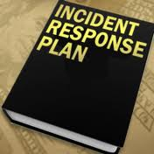
Keys to efficient incident response
Clear leadership
clear division of responsibilities & authorities
Established plan & processes
keep morale up, always learning from mistakes
Address stakeholder's expectations, and keep them informed
Incident responders who ask good questions
Plan is not public

Slide 6
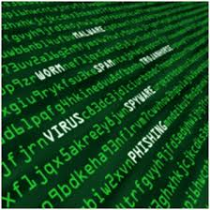
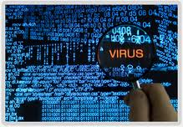
Dealing with stakeholder's effectively
Bosses / Stakeholders will be impatient.
Not understand the situation
Can make things worse
Can slow things down
Proper incident response != profit to them

Slide 7
Nuances of Incident Response
Record keeping is key
NOT STORED ON EXTERNAL SYSTEMS GOOGLE DOCS or public documents
Usually attackers are targeting PII, or stuff that shouldn't be anywhere OUTSIDE of your networks
Need-to-know basis, Sensitive information
Record the mistakes the team made
not to be used against the team, but to learn from
mistakes are common
Lots of 4am decisions + coffee
Usually law enforcement gets involved + chain of custody on evidence

Slide 8
Incident Response Phases
Preparation
Establishing a IR plan / team (very complicated)
Triage
Identify the mortally wounded systems, focus on the ones you can save
Containment
Scramble to understand the problem, communicate (quickly) what is known
Goal is to get to a point where the incident is no longer a direct threat
limit the scope of the incident
stop the bleeding / infection
Communicate to stakeholders possible root causes (ASAP)

Slide 9
Incident Response Phases
Response
Fix the problems (easier said than done)
Resolution
root cause analysis
root cause may be deep-seeded in organization, may be political & beyond scope of IR team
IR report
Aftermath:
Someone may get fired, goto jail, or get demoted
Usually few details are disclosed

Slide 10


When do you respond?
How are incidents identified?
What's suitable for just an IT ticket
What's suitable for a full fledged incident response?
False positives / False negatives
No perfect way

Slide 11
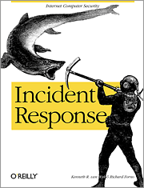
Indicators of Compromise
Indicator of Compromise = is a forensic artifact or remnant of an intrusion that can be identified on a host or network.
Used to communicate threat intelligence among defenders
Depends on attacker
Insider threat
Outside hacker
or hybrid
Depends on attack vector
over the network
malicious USBs

Slide 12
Indicators of Compromise
Straightforward indicators:
Anonymous dumps your corporate emails
Your corporate secrets are on Wikileaks
Audit reveals $$$$$ is missing
Not-so-straightforward indicators:
You find out from the news
Whistle blower?
legitimacy? Imposter?
Leak?
of future product plans / IP
of mergers
of quarterly performance

Slide 13
Indicators of Compromise
General Examples:
Database tables missing
Systems crashing
Strange traffic on the network
User machines abnormally slow?
IDS alerts

Slide 14
Indicators of Compromise
Realistic examples:
Combinations of suspicious metadata on a *victim's* system plus complex malicious code (Say a packed .dll or .exe)
creation of suspicious registry keys + mutexes

Slide 15
IOC standards
The Incident Object Description Exchange Format
http://www.openioc.org/
http://www.ietf.org/rfc/rfc5070.txt

Slide 16
Response / Containment
After identifying the vector(s), perhaps:
Fix firewall rules
add malware signature to IDS/AV
identify full extent of compromise

Slide 17
Results from a proper Incident Response
Damage contained / stopped
Attacker's vector identified / stopped
Hopefully patched, or in the process of being secured
Incident response report
Impact of breach
details of the scope & damage done
Details of breach
How you addressed the incident
with IR budget
technical steps
indicators of compromise
How it was fixed & steps to take in the future
more pentesting?

Slide 18
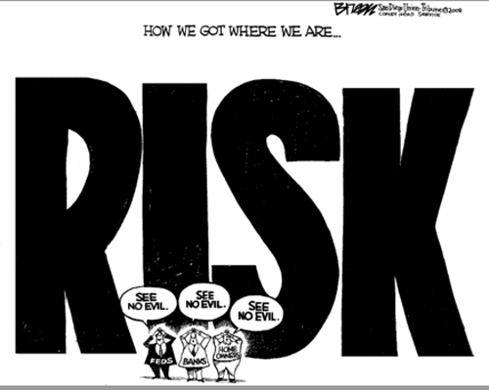
RISK
Company's risk:
should be reviewed
perhaps updated

Slide 19
IR toolkit
(Not comprehensive)

Slide 20
Depending on what you can afford
EnCase ($$$$$$$$$$$$$$$$$$$$$$$$$$)
Commercial IDS/IPS
The Sleuth Kit
Volatility
SysInternals Suite
IDA pro
A debugger
Immunity, Ollydbg, WinDbg, etc...
(Not comprehensive list)

Slide 21
Volatility
a framework for extracting digital artifacts from RAM samples (virtual memory dumps)
32bit / 64bit Windows XP, 2003, Vista, 7
Has two interfaces
single-command command line binary
the interactive volshell

Slide 22
intermission to look at the volatility cheat sheet

Slide 23
Getting a memory dump for Volatility
A memory dump = binary file containing complete contents of systems memory
I use MoonSol's memory dump tools to get my memory dumps
http://www.moonsols.com/windows-memory-toolkit/

Slide 24
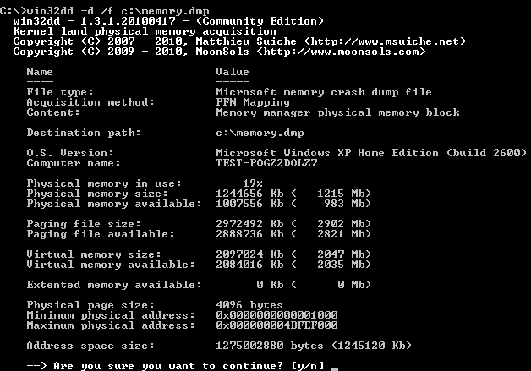
Using moonsols
win32dd (for 32bit) win64dd (for 64bit)

Slide 25
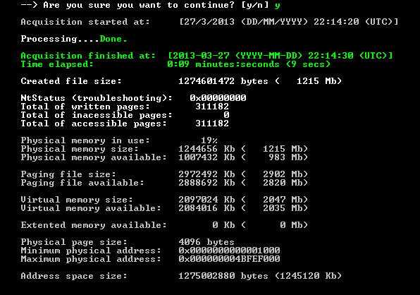
Using moonsols
General output

Slide 26
Using Volatility
Given a memory dump, we can analyze:
process list / thread list
process memory
connections
sockets
dlls
malware / backdoors in memory
which may leave zero forensic evidence on disk!
helpful volatility options
-h for help
-v for verbose

Slide 27
Volatility nuances
silently fails given bad commands/options
volatility's options are mostly community-written plugins
fail in weird ways
don't always work
don't work for all versions of windows
don't work for IPv6
process memory dumps on malware/backdoors will often trigger your AV

Slide 28

Demo time
Volatility + Ida + yara

Slide 29
Scenario
I've exploited a vulnerable windows system with a meterpreter payload. I ran:
getsystem
execute -f calc.exe
migrate (to calc.exe)
Then on the victim I acquired a memory dump at this moment afterwards.

Slide 30
Using volatility to find bad stuff
malfind plugin helps find hidden / injected code blocks in user mode memory.
Based off of VAD tag and page permissions
Can't detect DLL's injected into a process using CreateRemoteThead->LoadLibrary
Still helpful...
Common tactic of hackers, malware
Not a silver bullet
YMMV

Slide 31
A site note on finding injected/hidden DLLs
malfind
idrmodules
dlllist
impscan
...

Slide 32
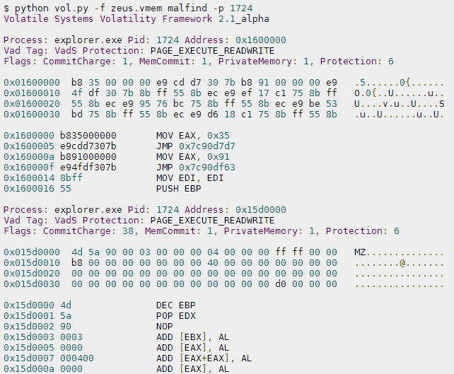
Example of malfind to detect Zeus malware family: (not demo related)
From: https://code.google.com/p/volatility/wiki/CommandReferenceMal22

Slide 33
Ok to the demo
With the memory dump of the victim machine,
we're going to do:
Triage/Containment
Response
Resolution

Slide 34
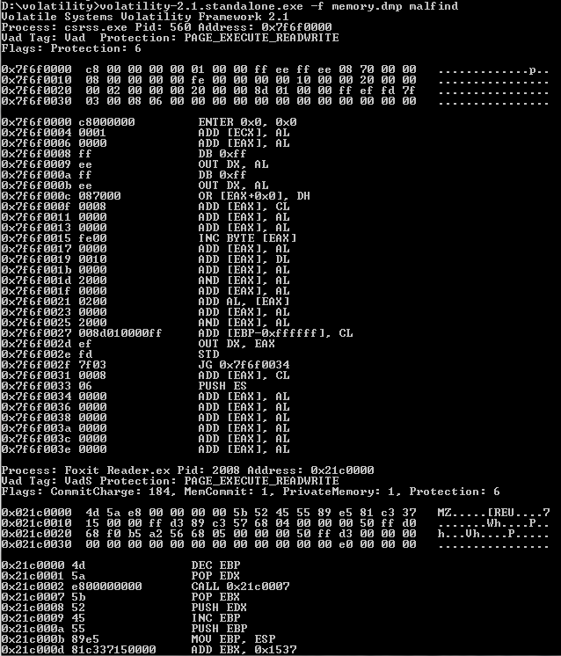
Results from malfind

Slide 35
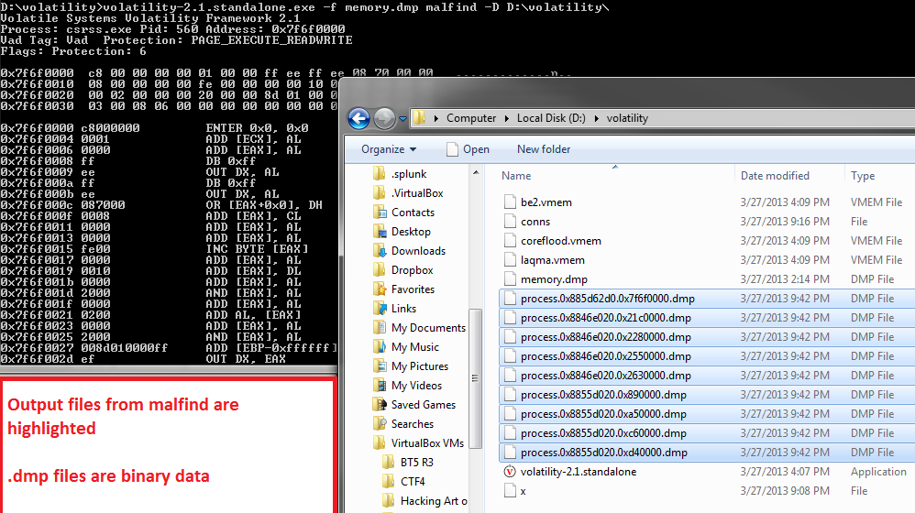
malfind -D C:\output\directory\...
Some are valid PE files...

Slide 36
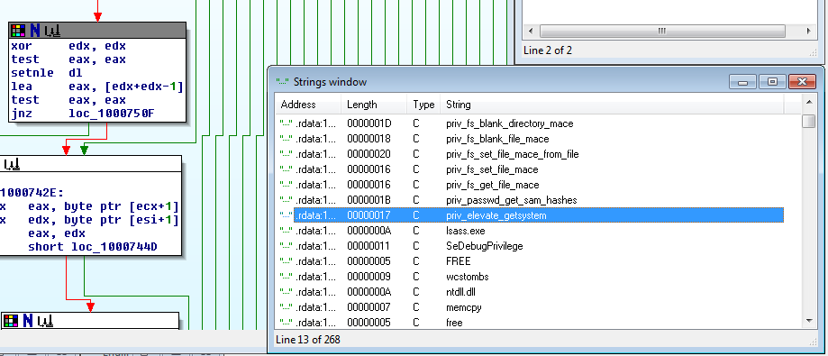
Investigation w/ IDA
Since when does calc.exe need "priv_elevate_getsystem"?
Why would calc.exe or any other process have these strings????

Slide 37
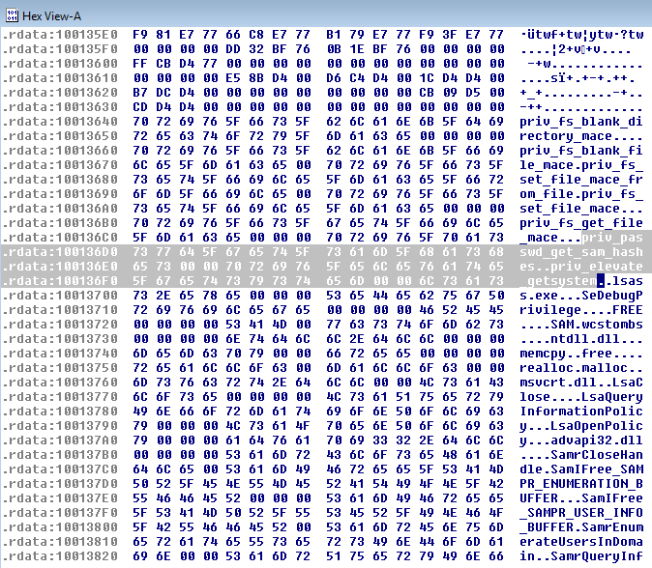
in the .rdata

Slide 38
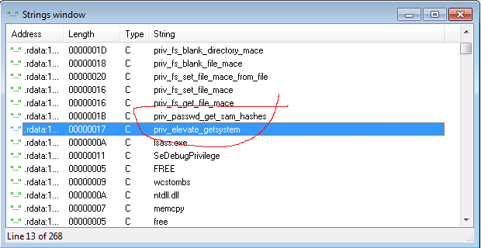
Indicator of Compromise
These two strings shouldn't exist in calc.exe, or really any process
Strong IoC
Strong signature too!

Slide 39
Containment
Given these strings, it is possible to write a signature to detect this
on Host-based-IDS
on AV
with custom RAT (perhaps)
Here's a Yara rule to detect meterpreter in memory:
rule MeterpreterDetected
{
strings:
$a = "priv_elevate_getsystem"
$b = "priv_passwd_get_sam_hashes"
condition:
$a and $b
}

Slide 40
Containment
First test the signature to see how many false positives occur - Building a whitelist to exclude processes may be necessary.
rule MeterpreterDetected
{
strings:
$a = "priv_elevate_getsystem"
$b = "priv_passwd_get_sam_hashes"
condition:
$a and $b
}

Slide 41
Containment
rule MeterpreterDetected
{
strings:
$a = "priv_elevate_getsystem"
$b = "priv_passwd_get_sam_hashes"
$whitelist1 = "smss.exe"
condition:
($a and $b) and not $whitelist1
}
If all is good, establish a whitelist, then update HIDS systems with this Yara rule, with the action to kill any matching process.
All open meterpreter sessions will be killed (hopefully)

Slide 42
A side note
"priv_elevate_getsystem" and "priv_passwd_get_sam_hashes"
are part of the meterpreter standard api dll - which is loaded every time by default
does not indicate that the attacker has compromised a SYSTEM token

Slide 43
Alternate rules
Strings for signatures can be text and/or hexadecimal. Also wildcards..
example:
$hex_string = { A2 34 ?? C8 A? FF }

Slide 44
Who uses Yara
VirusTotal Intelligence
jsunpack-n
FireEye
We Watch Your Website
ClamAV (with a yara extension)
...
Volatility!!!
yarascan :D
But only two of these are a HIDS / AV

Slide 45
Response
Further investigation is needed to determine how the attack happened
We can use yarascan to automate the detection of the attackers in any other memory dumps, with our yara rule
(not going to demo this... just a fun fact)

Slide 46
Response
We want to:
Identify where the attacker is coming from
Identify whether the attacker compromised the SYSTEM token
if so, then there's a higher chance of a rootkit

Slide 47
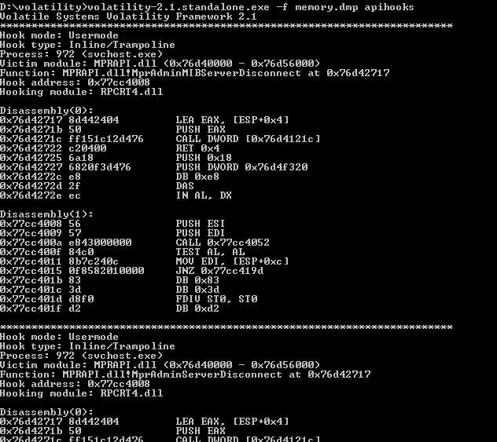
apihooks

Slide 48
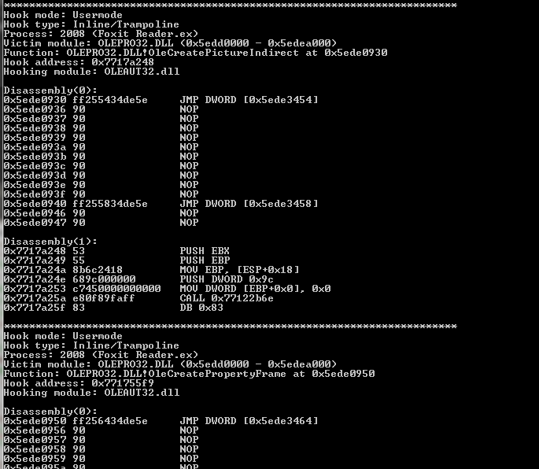
apihooks...

Slide 49
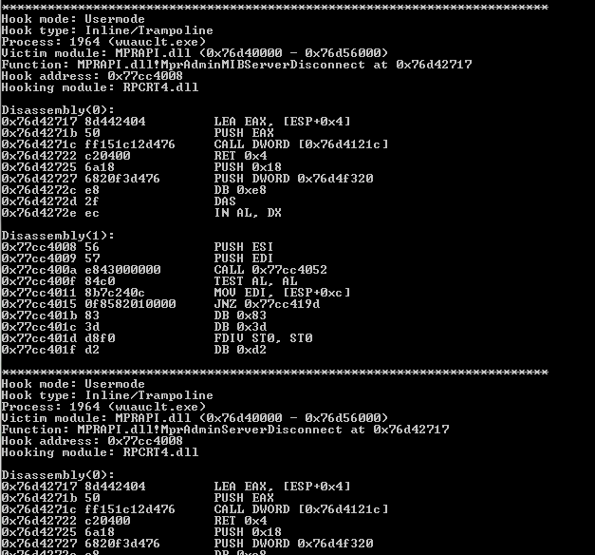
apihooks....

Slide 50
Analysis
We've detected API hooks present in:
svchost.exe (SYSTEM process)
Foxit Reader.exe (user process)
wuauclt.exe (user process)
windows autoupdate client
What could these indicators mean?

Slide 51
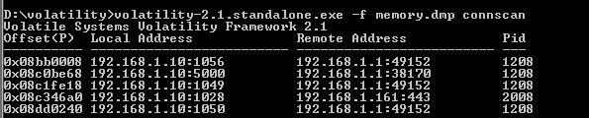
Analyzing the open connections
connscan can be very slow, but we see 4 connections open, among two IP addrs
192.168.1.10 - 192.168.1.1 (gateway)
192.168.1.10 - 192.168.1.161
Normally have to sift through lots of connections

Slide 52
Conclusion
We used Volatility to find:
The backdoor
The compromised process
The attacker's IP
An indicator that the attack vector was a Foxit Reader.exe exploit
and an indicator that the attacker compromised a SYSTEM token
API hooks in SYSTEM process svchost.exe
In many scenarios attackers will leave zero disk forensic evidence --- and the only evidence will be in volatile memory...

Slide 53
Volshell
This is a interactive (but limited) shell in the volatility framework given a memory dump.
Built on top of Python interpreter
can leverage everything in Python
>volatility-2.1.standalone.exe -f be2.vmem --profile=WinXPSP2x86 volshell
or
$ python volatility volshell -f xp-laptop-2005-07-04-1430.img
For help:
hh()
http://moyix.blogspot.com/2008/08/indroducing-volshell.html

Slide 54

\x00
Questions?

